Slide 1

Shri Vaishnav VidYapeeth Vishwavidyalaya
Department of Computer Science Engineering
Subject:- Major Project
Topic:- Digital Voting Dock
Guided By: Submitted by:
Mr. Sanat Jain Sandeep Choudhary
Yatharth Bhatnagar
Yuvraj Singh Rathore
Amarpreet Singh Bhatia

Slide 2
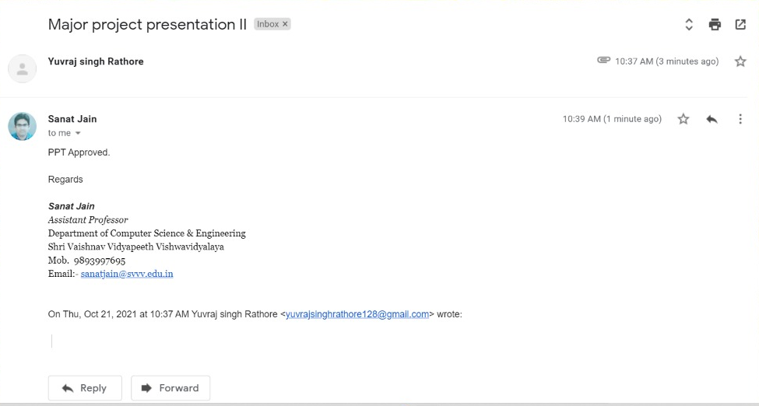

Slide 3

Digital Voting Dock

Slide 4
Table of Contents
Problem Domain
Literature Survey
Feasibility Study
Conceptual Diagrams
Demonstration(Screenshots)
References

Slide 5

Problem Domain
As information technology evolves over time, the need for a better, faster, more convenient techniques are required to replace the old ones.
Long waiting time discourages people from voting.
Funding Elections.

Slide 6

Literature Survey
PARAMETER | DVD(Digital Voting Dock) | EBALLOT | POLYAS | ELECTION BUDDY
PRICING | FREE | PAID | PAID | PAID
REAL TIME SUPPORT | YES | YES | YES | YES
E-MAIL VOTING | NO | YES | NO | NO
ELIGIBILITY CHECK | YES | NO | NO | NO

Slide 7
Feasibility Study
Technical Feasibility
In Technical Feasibility current resources both hardware software along with required technology are analyzed/assessed to develop project. Feasibility study also analyzes technical skills and capabilities of technical team, existing technology can be used or not, maintenance and up-gradation is easy or not for chosen technology etc.
Operational Feasibility
In Operational Feasibility degree of providing service to requirements is analyzed along with how much easy product will be to operate and maintenance after deployment. Operational scopes are determining usability of product, Determining suggested solution by software development team is acceptable or not etc.
Economic Feasibility
In Economic Feasibility study a detail analysis is carried out what will be cost of the project for development which includes all required cost for final development like hardware and software resource required, design and development cost and operational cost and so on.

Slide 8
Conceptual diagrams
1. Data Flow Diagram
2. ER Diagram
3. Use-Case Diagram
4. Activity Diagram
5. Sequence Diagram

Slide 9

Data flow diagram-0

Slide 10
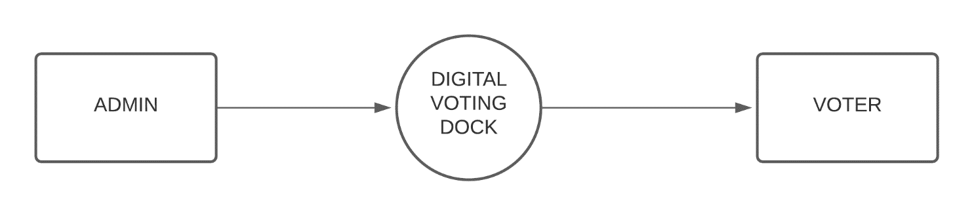

Slide 11
Data flow diagram-1

Slide 12
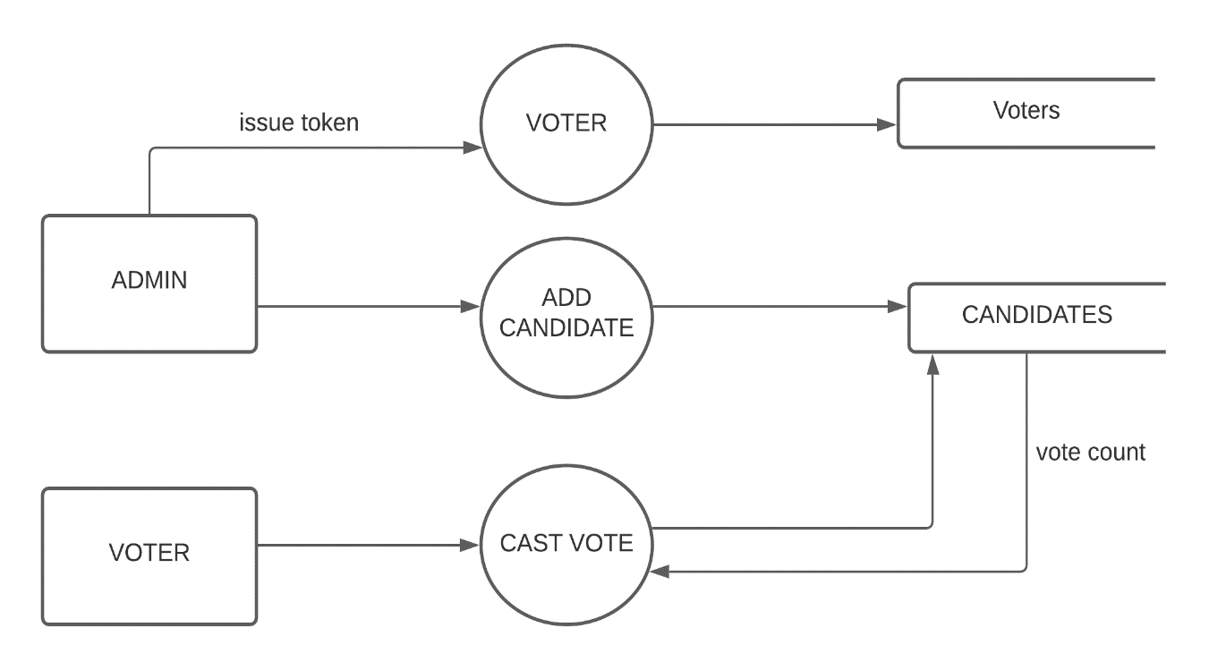

Slide 13

ER DIAGRAM

Slide 14
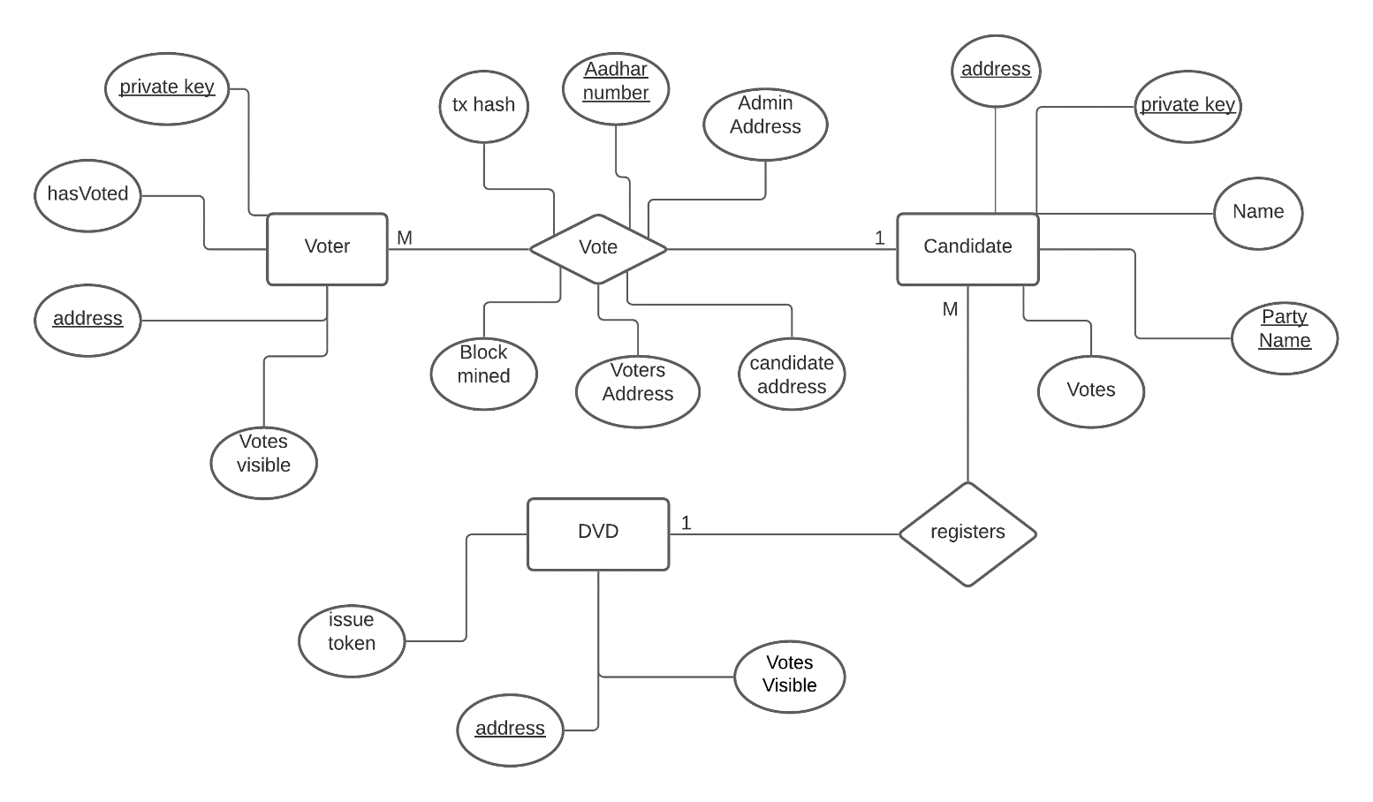

Slide 15

Use-case diagram

Slide 16
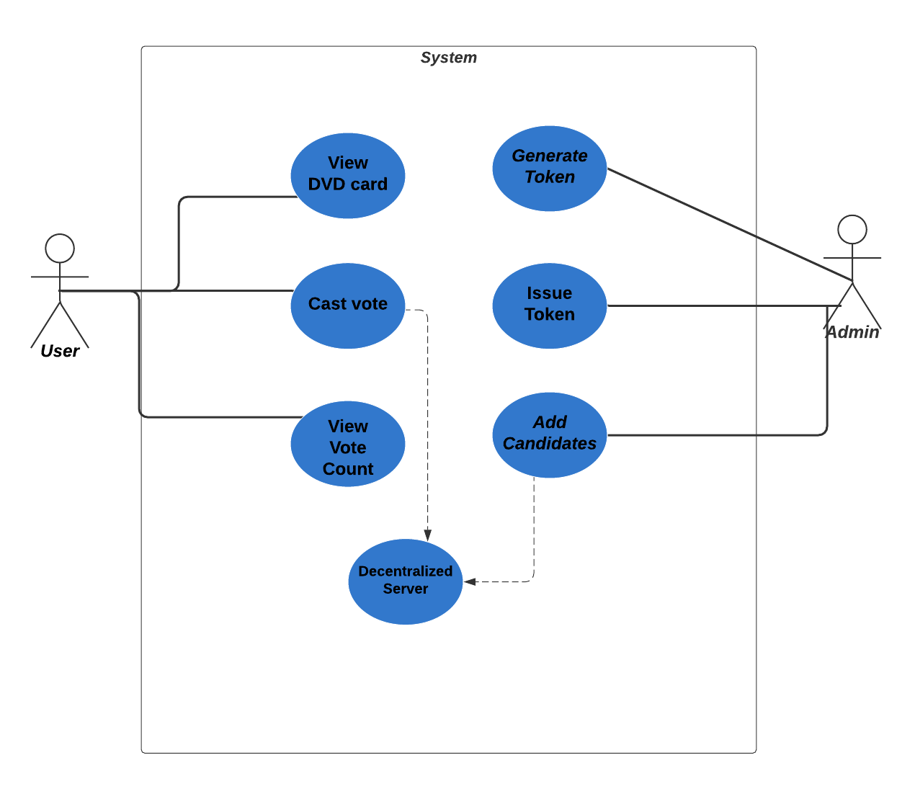

Slide 17

Activity diagram

Slide 18
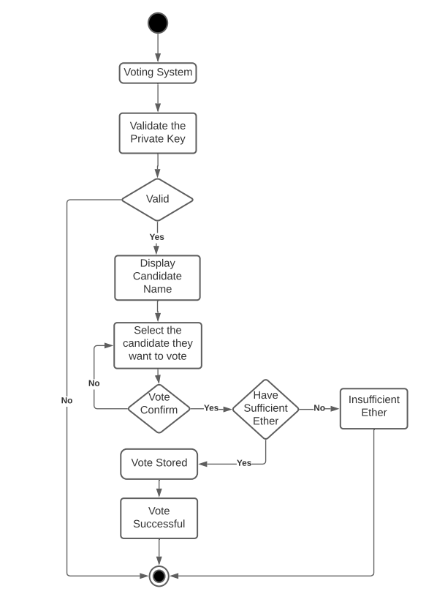

Slide 19

Sequence diagram

Slide 20
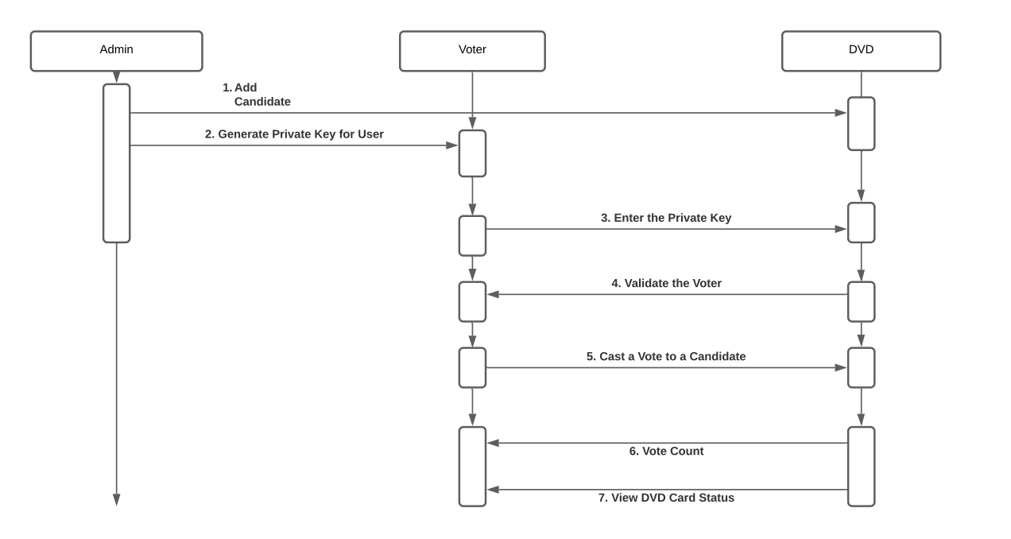

Slide 21
STATE DIAGRAM

Slide 22
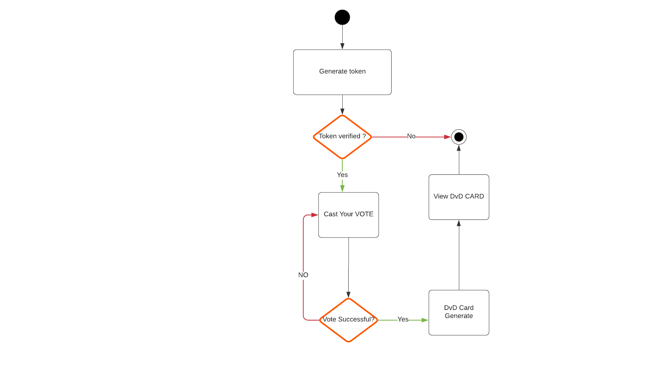

Slide 23

DEMONSTRATION

Slide 24

LANDING PAGE/HOME PAGE

Slide 25
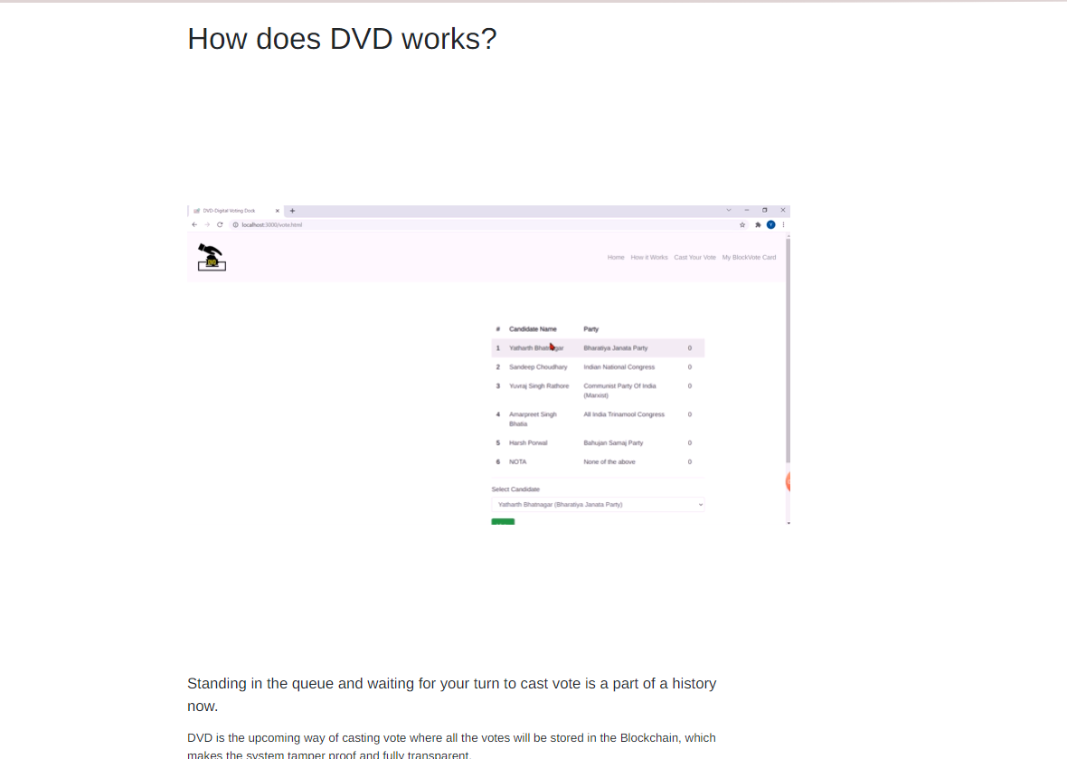
HOW IT WORKS

Slide 26
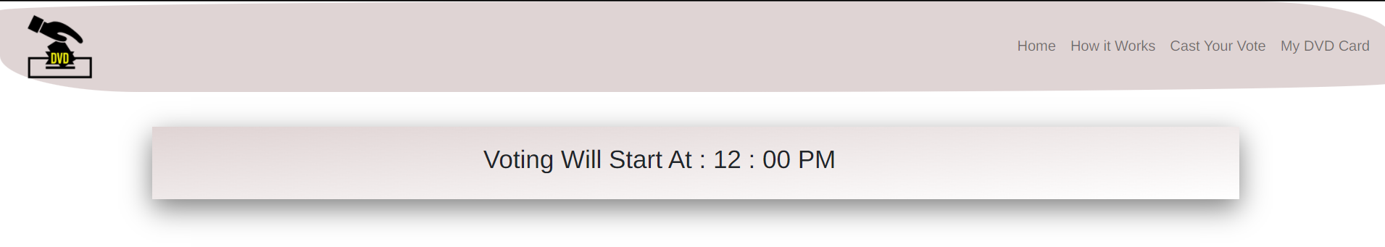
CASTE VOTE PAGE BEFORE VOTING TIME

Slide 27
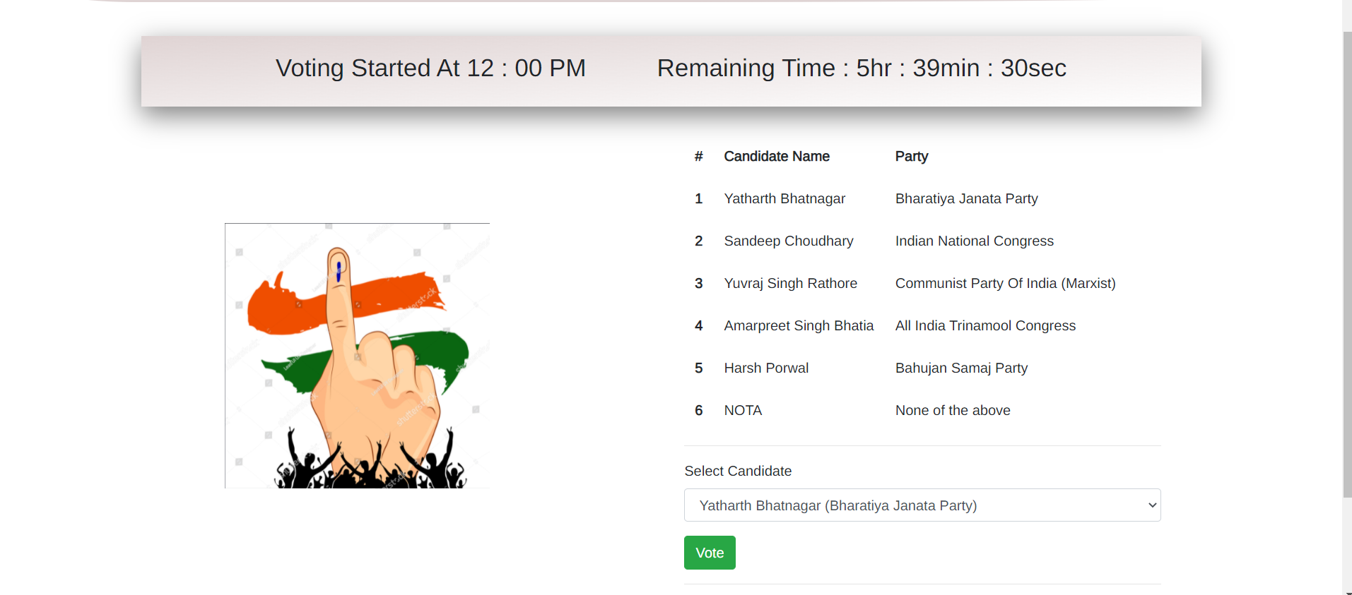
CASTE VOTE PAGE- DURING VOTING PHASE

Slide 28
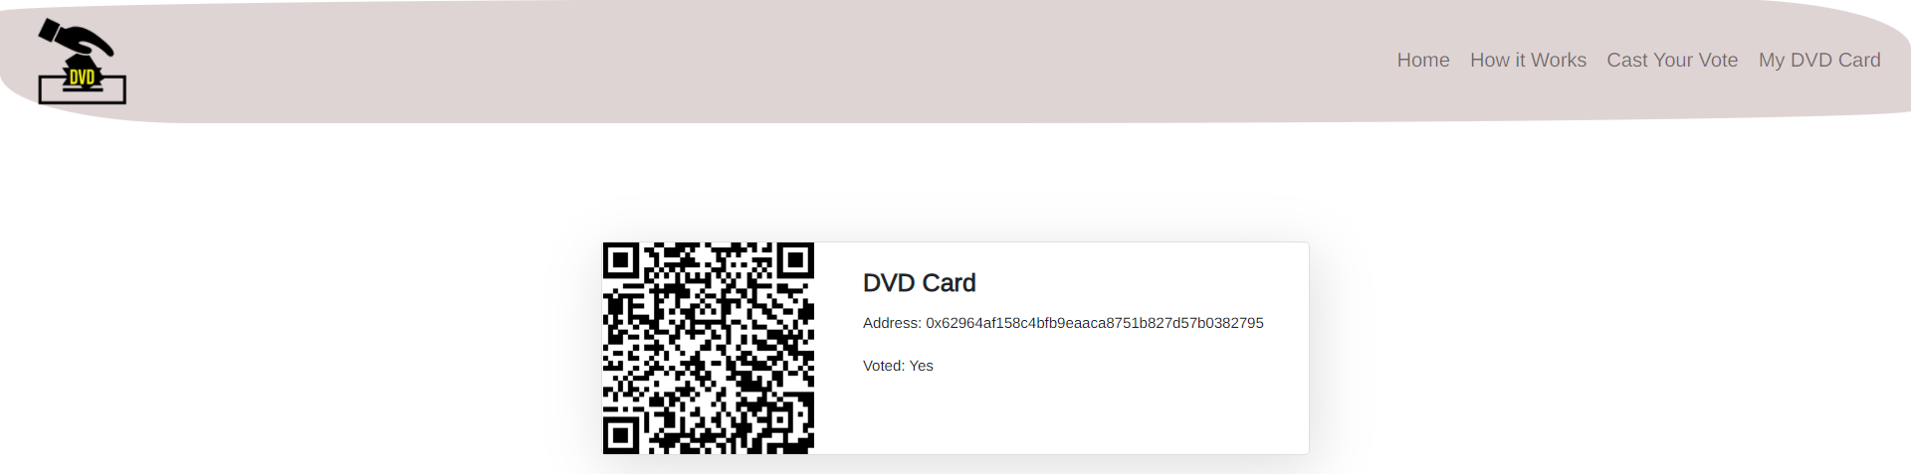
MY DVD CARD

Slide 29
References
[1] Online Voting System- http://www.ijtrd.com/papers/IJTRD185.pdf
[2] Blockchain based E-voting Technology- https://www.itm-conferences.org/articles/itmconf/pdf/2020/02/itmconf_icacc2020_03001.pdf
[3] Eballot Voting Website - https://www.eballot.com/
[4] Polyas Voting Website - https://www.polyas.com/
[5] Election Buddy Website - https://electionbuddy.com/
[6] Problem Domain - https://theknowledgeexchangeblog.com/2019/05/30/five-challenges-facing-the-people-who-make-elections-happen/

Slide 30

Thank You

